Slide 1

Voxellancer
I believe I can fly
by Patrick Siegler, Sebastian Gerstenberg, Christian Dullweber and Moritz Eyssen under guidance of Daniel Limberger

Slide 2
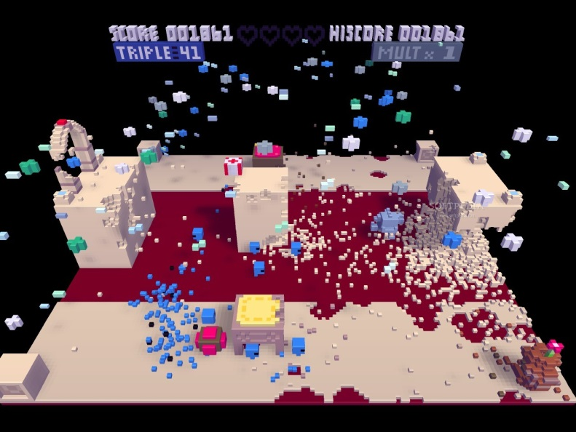
Motivation Voxels
Fully destructable World
Accurate textbook physics:
collision
destruction
Impacts
Simple model design
As previously seen in games like:
Voxatron
Minecraft

Slide 3
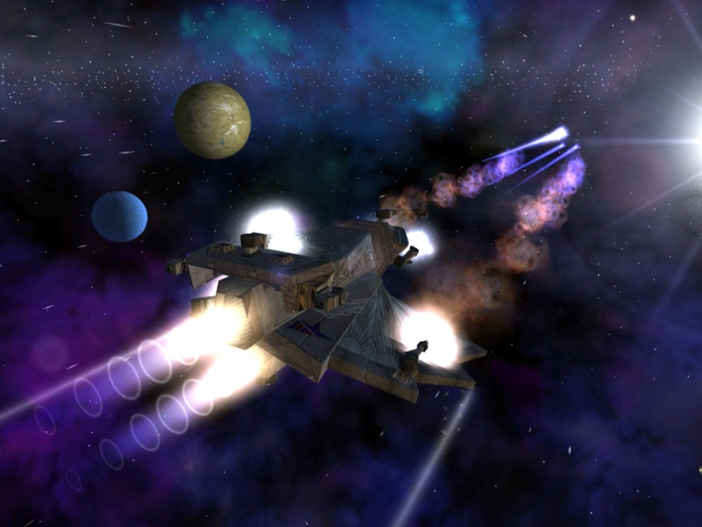
Motivation Space
Space Games are awesome
Dogfight combat
Science Fiction setting
Open world
Not limited by „realism“
As previously seen in games like:
Freelancer
X-Series
Eve Online

Slide 4
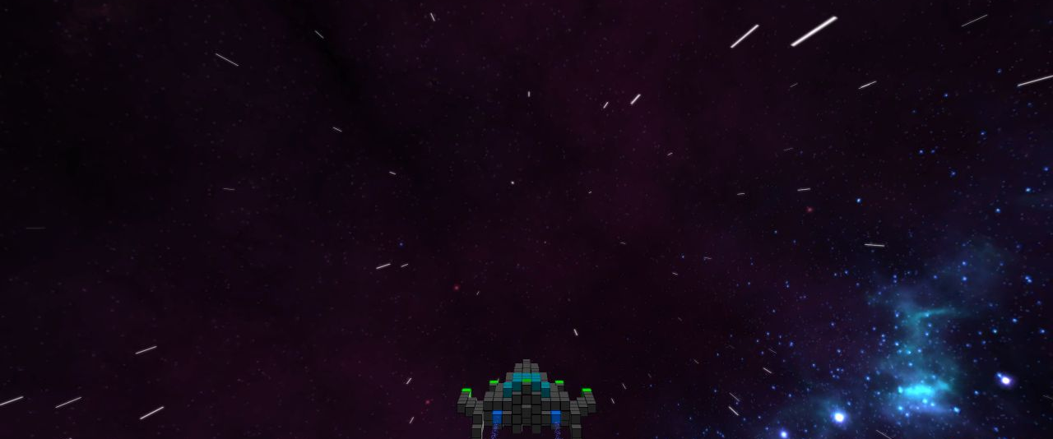
Trailer

Slide 5
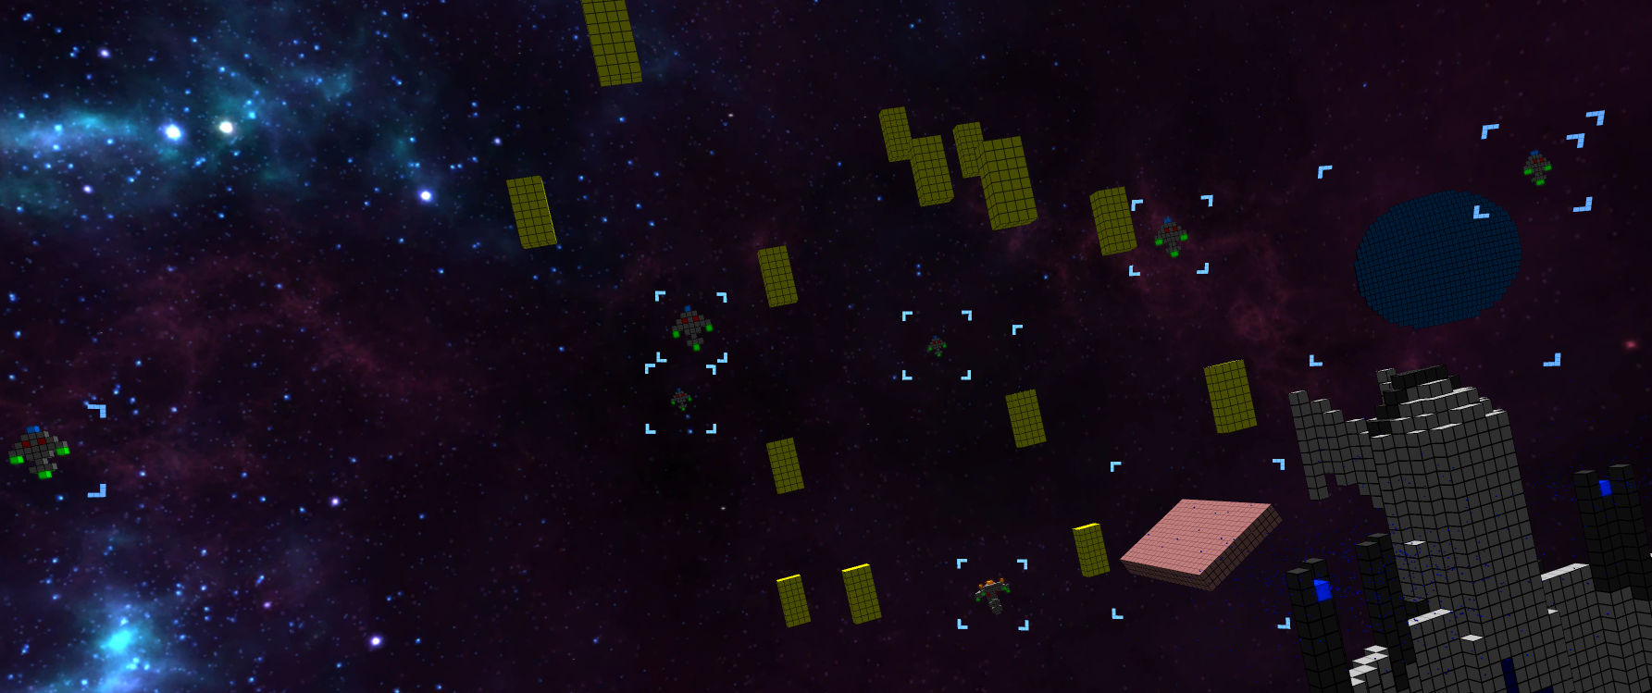
Features

Slide 6
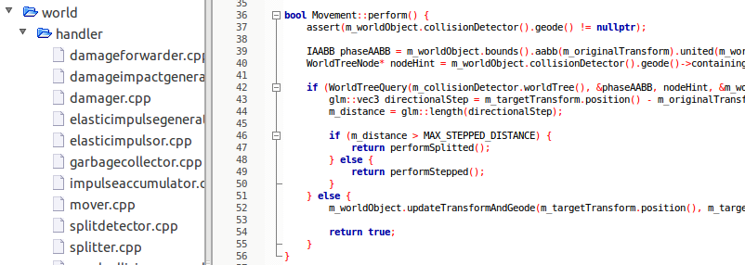
Engine
From-scratch-engine managing:
Physics
CollisionDetection
Damage
Splitting
24.03.2013
Gameprogramming 2013 - Voxellancer
6

Slide 7
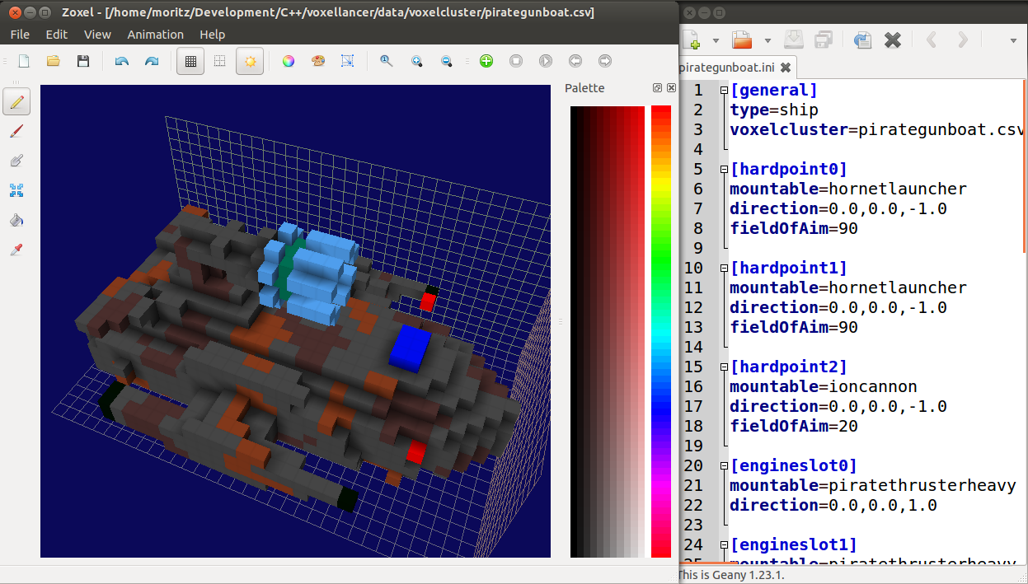
Modeling
24.03.2013
Gameprogramming 2013 - Voxellancer
7

Slide 8
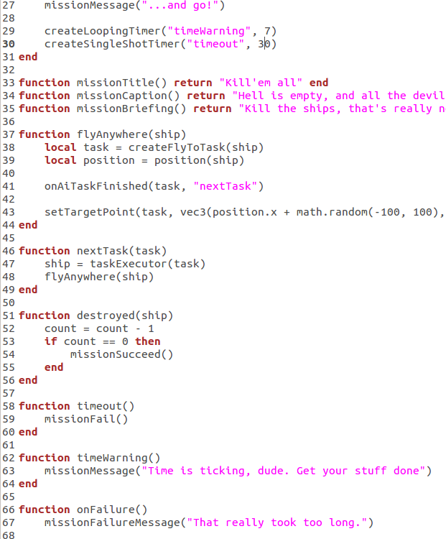
Scripting
24.03.2013
Gameprogramming 2013 - Voxellancer
8

Slide 9
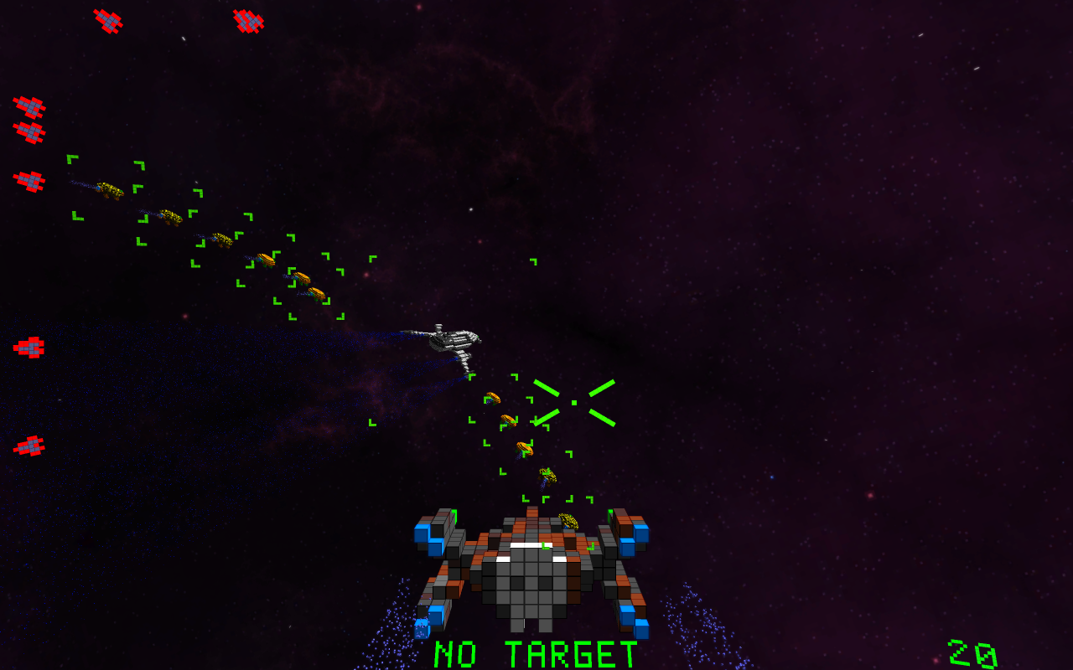
AI and Squads
24.03.2013
Gameprogramming 2013 - Voxellancer
9

Slide 10
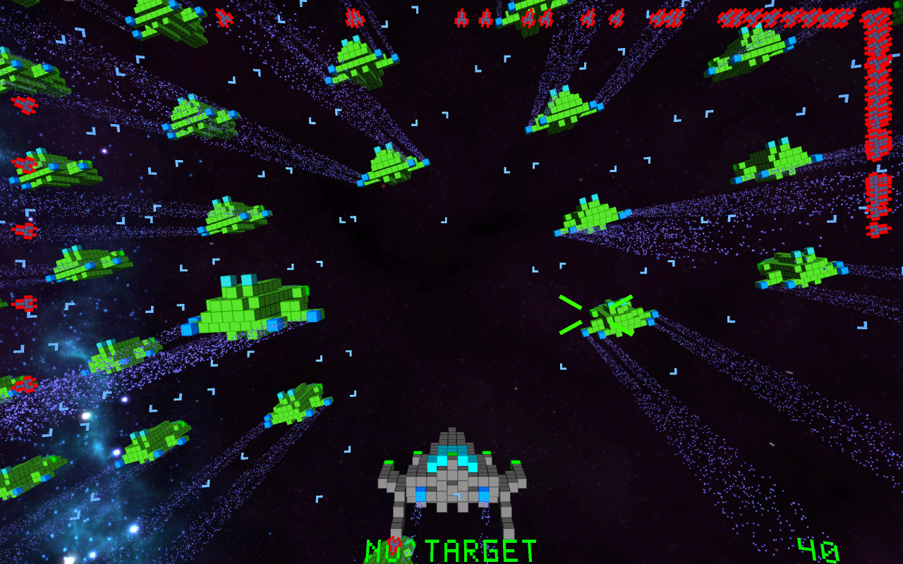
ParticleEngine
and Effects
24.03.2013
Gameprogramming 2013 - Voxellancer
10

Slide 11
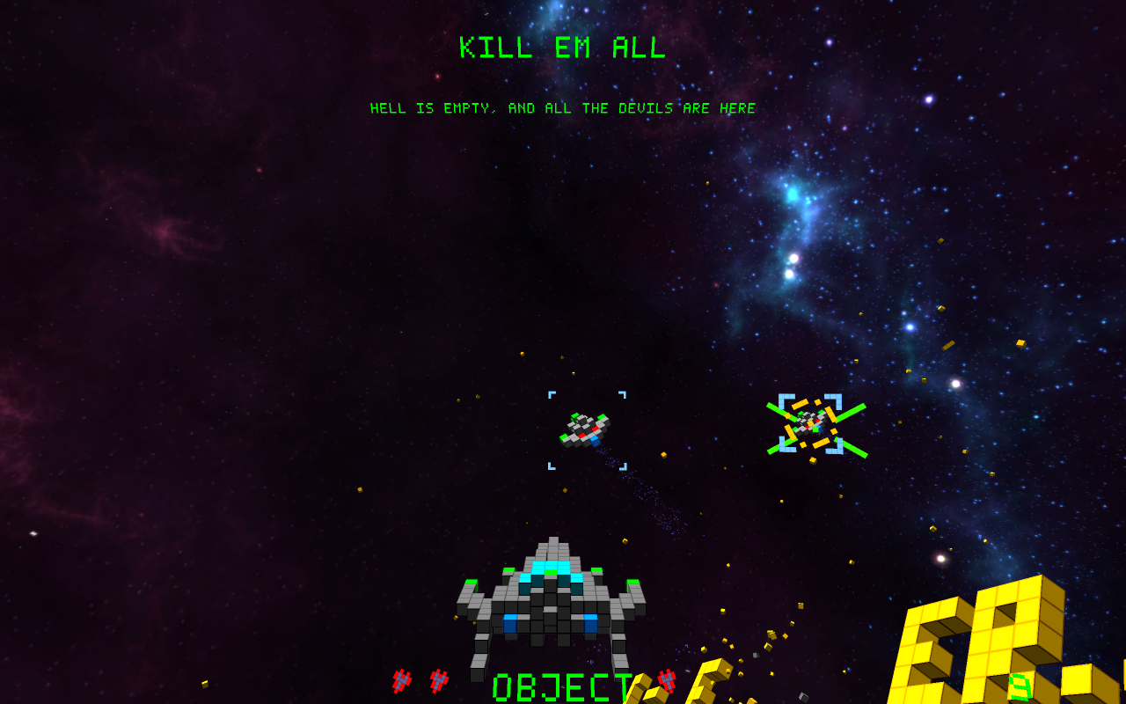
HUD
24.03.2013
Gameprogramming 2013 - Voxellancer
11

Slide 12
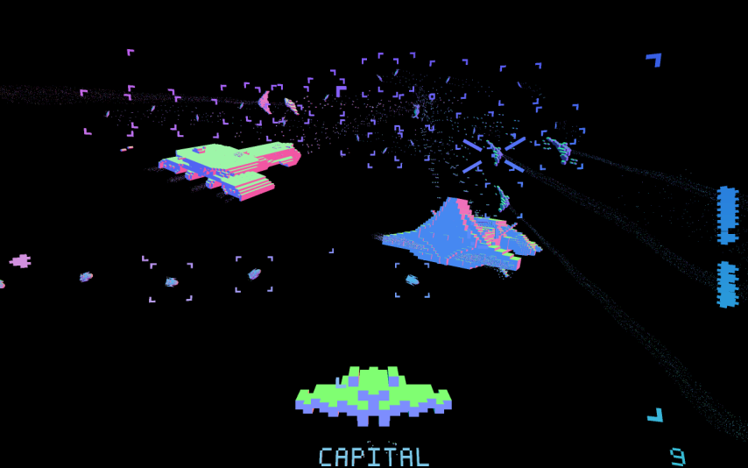
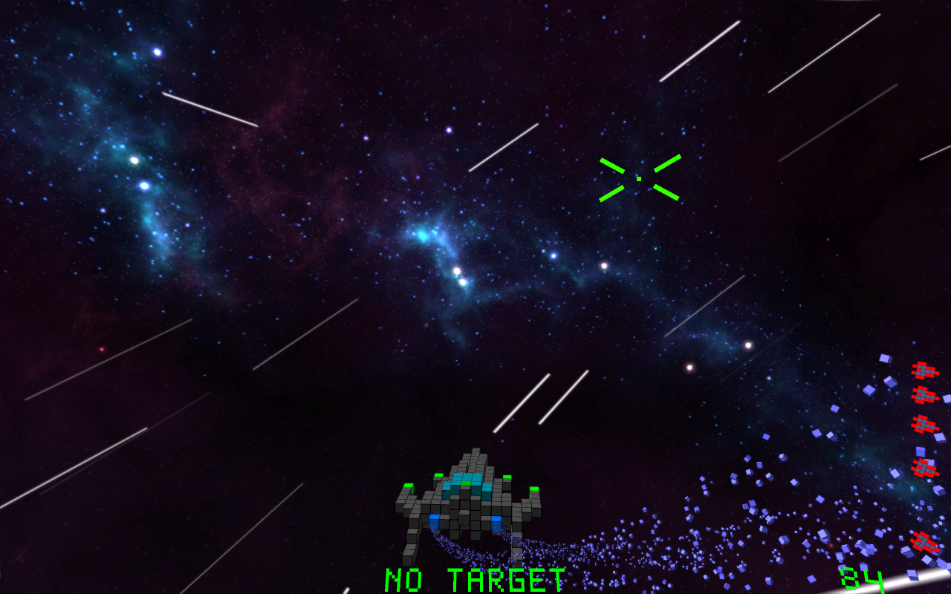
Postprocessing
24.03.2013
Gameprogramming 2013 - Voxellancer
12

Slide 13
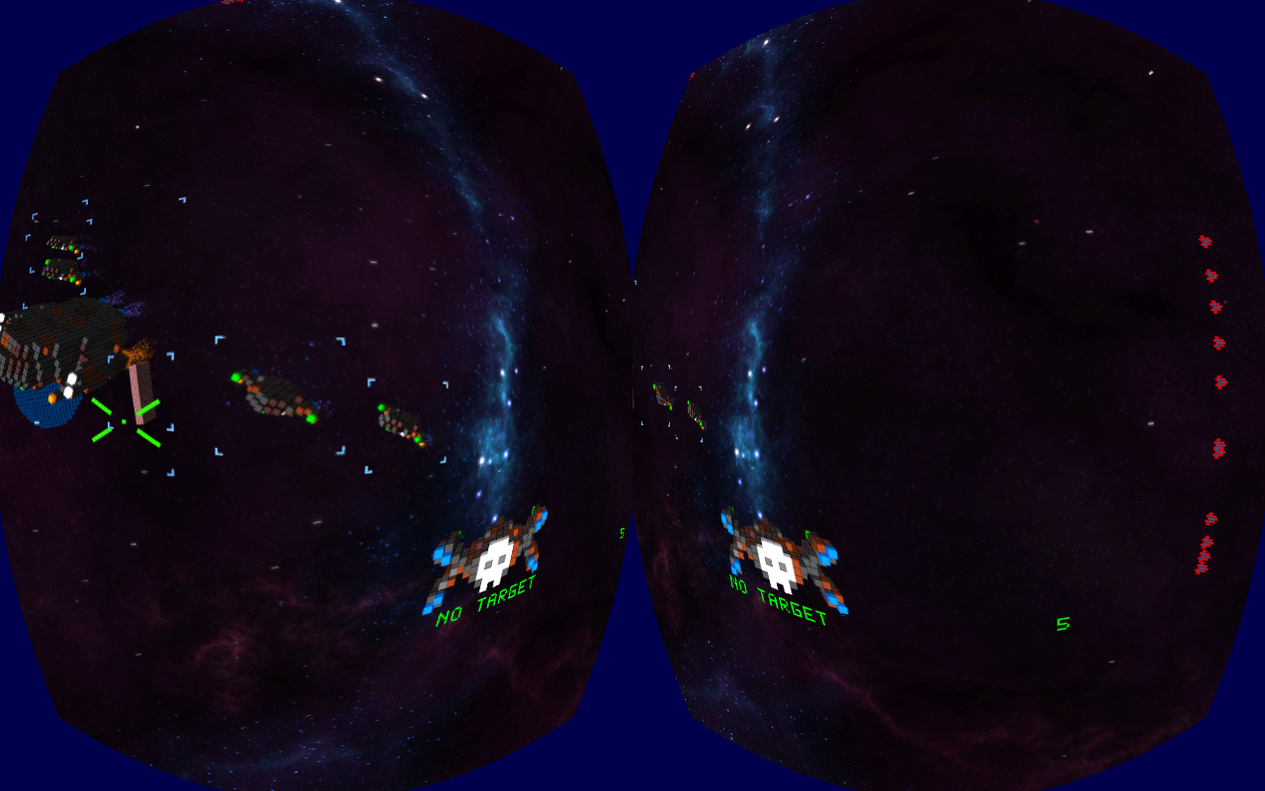
Oculus Rift
24.03.2013
Gameprogramming 2013 - Voxellancer
13

Slide 14
Misc.
3D Audio (engine-sound, explosions...)
Factions
Configureable Gamepad and Joystick support
Equipment, i.e. Weapons and Engines are changeable
Homing missiles
...
24.03.2013
Gameprogramming 2013 - Voxellancer
14

Slide 15
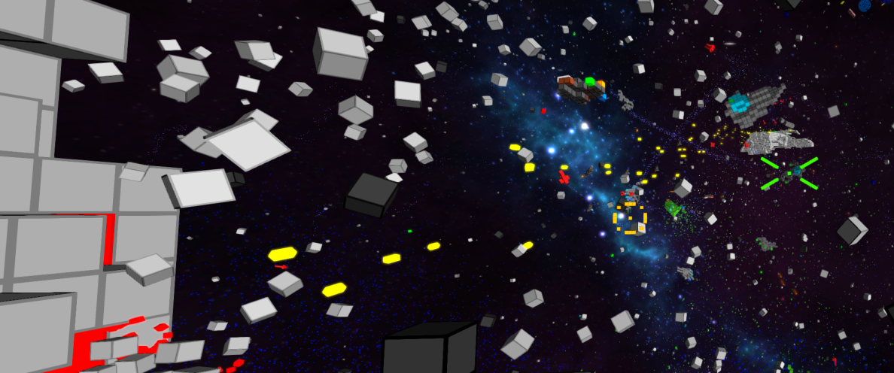
Behind the Scenes

Slide 16
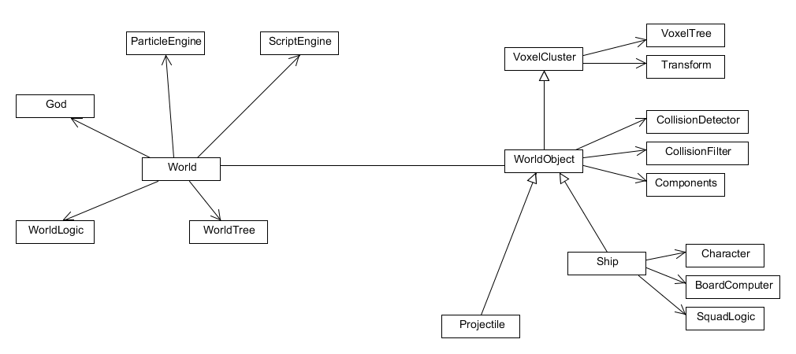
Quick Overview

Slide 17
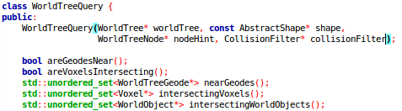
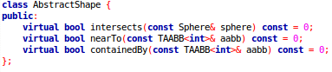
OctTree with unbalanced depth and dynamic covered AABB
Split/Merge leafs depending on object-count
Objects know in which Leafs they are located
WorldTreeQuery:
AbstractShape:
WorldTree
24.03.2013
Gameprogramming 2013 - Voxellancer
17

Slide 18
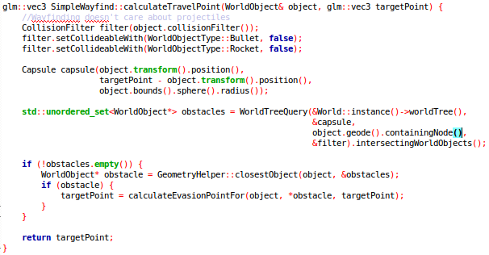
Usage
AI wants to know if path to waypoint is clear
Compose capsule that contains object during the movement
Ask WorldTreeQuery for objects colliding with this capsule
[Calculate intermediate waypoint to evade nearest obstacle]
24.03.2013
Gameprogramming 2013 - Voxellancer
18

Slide 19
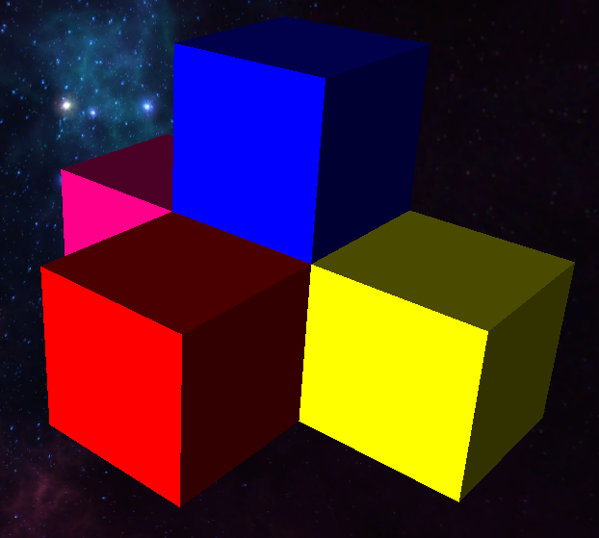
VoxelCluster
Represent all entities
Datastructures
std::unordered_map<glm::ivec3, Voxel*>
VoxelTree
std::set<Voxel*, VoxelGridCmp<XAxis>>
std::set<Voxel*, VoxelGridCmp<YAxis>>
std::set<Voxel*, VoxelGridCmp<ZAxis>>
glow::ref_ptr<glow::VertexArrayObject>
struct VoxelData { glm::vec3 position; uint32_t color; float emissiveness; };

Slide 20
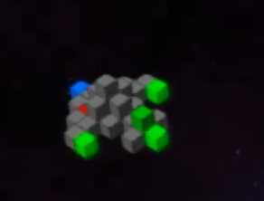
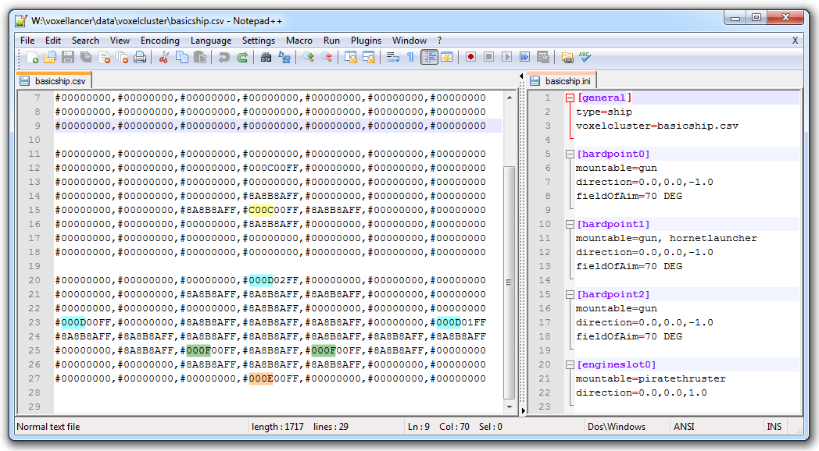
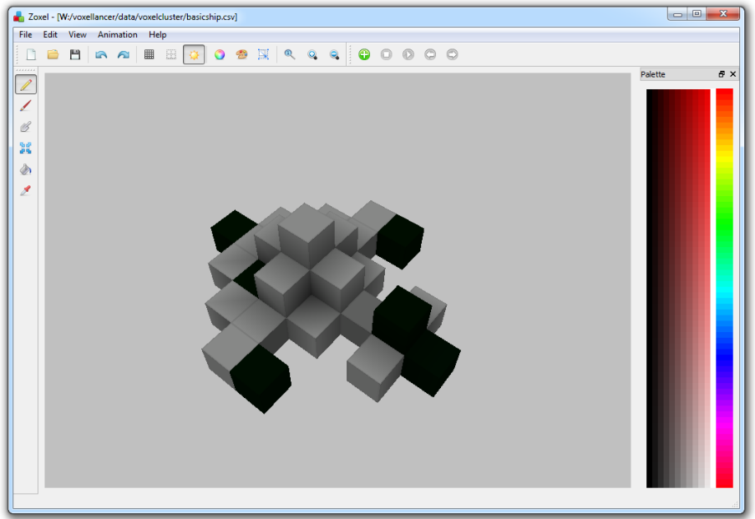
Models
Modeled in Zoxel, configured via .ini
Models are designed in Zoxel, Special Voxels encoded via special colors
The actually installed Weapon/Engine defines color and behaviour ingame

Slide 21
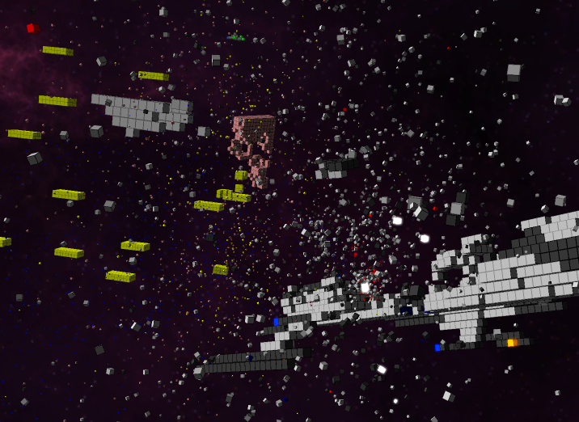
Particles
Simulated on GPU
struct VoxelParticleData { glm::vec3 creationPosition; glm::vec3 creationEulers; glm::vec3 directionalSpeed; glm::vec3 angularSpeed; float creationTime; float deathTime; float scale; uint32_t color; float emissiveness; };
VertexShader:
float timeDelta = currentTime - creationTime;
vec3 particlePosition = directionalSpeed * timeDelta + creationPosition;
vec3 eulers = angularSpeed * timeDelta + creationEulers;
vec4 orientation = quat(eulers);
gl_Position = viewProjection * vec4(qtransform(orientation, v_vertex) * scale + position, 1.0);
→ Very few buffer updates neccessary!

Slide 22
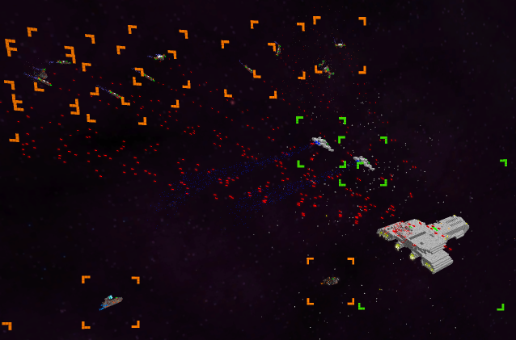
AI - Tasks
NPC behaviour split into Tasks
Tasks completly designed in C++
Single Unit Tasks and Group Tasks
Tasks make use of other tasks, to simulate complex behavior
Squads are groups of NPCs joining together to perform a mutual task

Slide 23
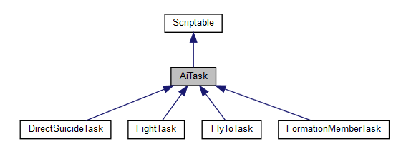
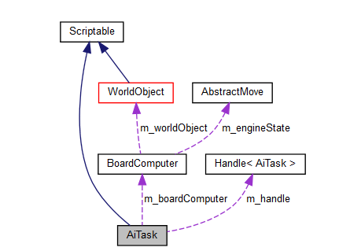
Single Unit Tasks

Slide 24
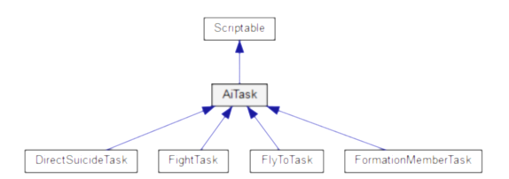
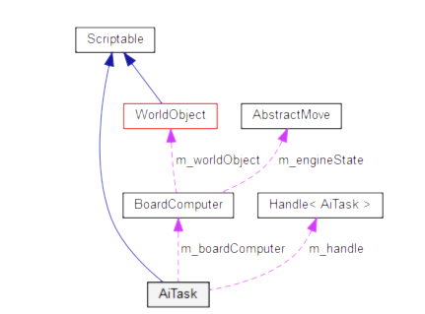
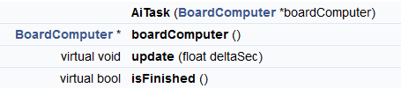
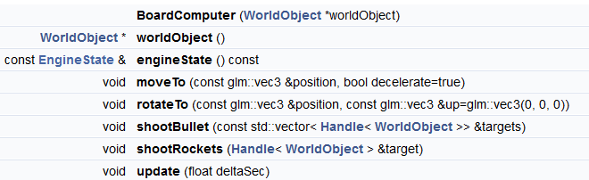
Single Unit Tasks

Slide 25
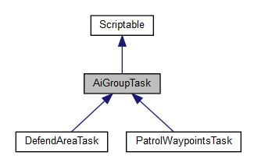
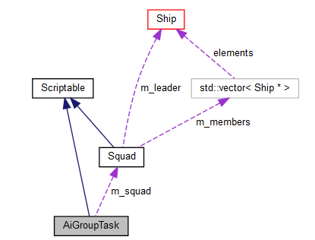
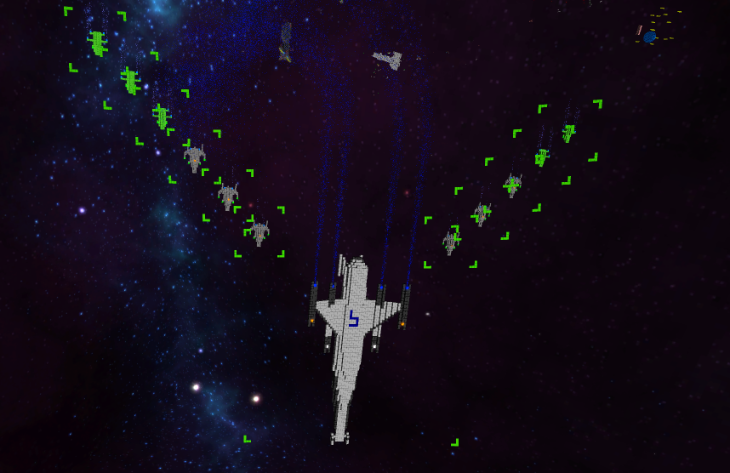
Group Tasks

Slide 26
HUD
All HUD elements are made up of Voxels
Text is created with out own Voxelfont
All HUD Elements are located on a Sphere around the Camera

Slide 27
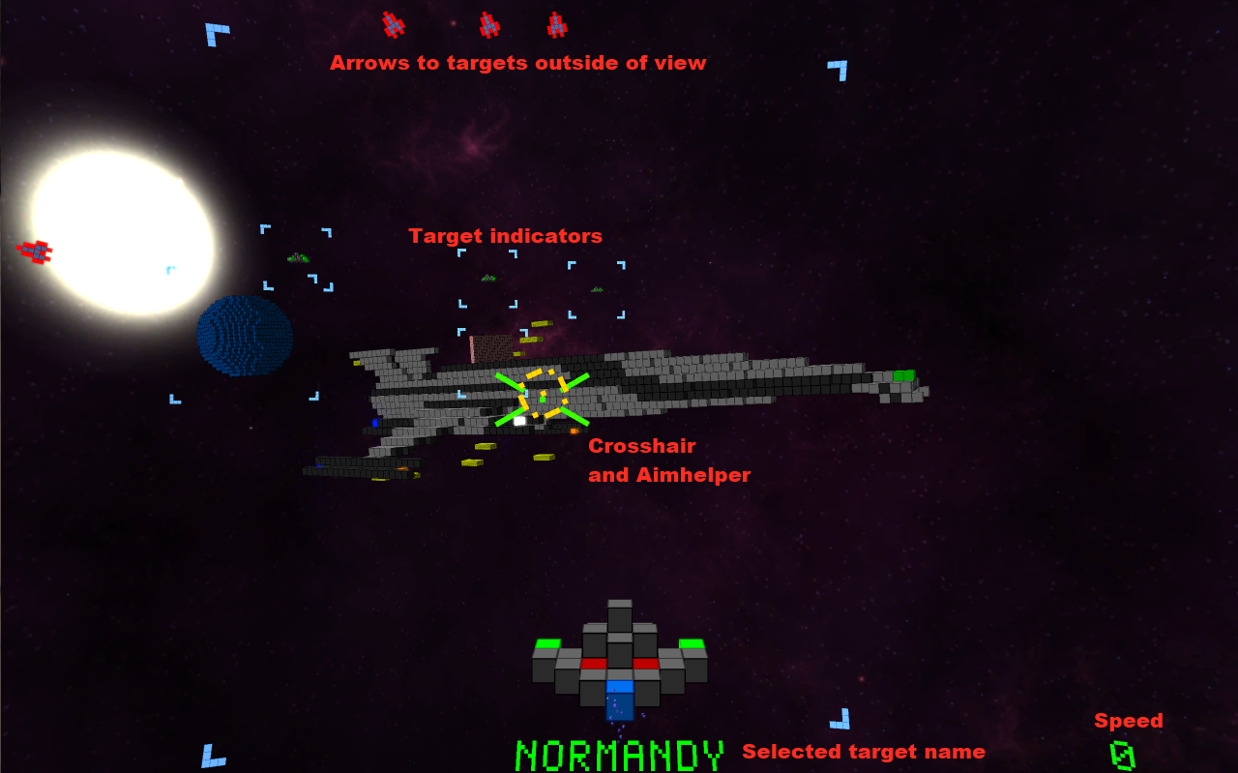
HUD explained

Slide 28
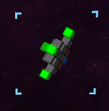


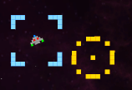

Hudgets
HUD is composed of different elements called „Hudgets“ (HUD-Widgets)
All Hudgets can update their own position and appearance, according to the game situation.
ObjectHudgets mark other Worldobjects
Crosshair
AimHelper indicates where to aim, to hit a moving object
TextHudgets and Buttons

Slide 29
Spherical HUD
HUD elements are placed on a sphere around the camera
Sphere (supposivly) allows easy integration with Oculus Rift
Creates a „HUD on Helmet“ illusion
Spherical HUD creates problems on the Rift for hudgets outside of the focus.
Due to the different viewing angles and distance to hudgets along the edges, the hudgets appear twice.

Slide 30
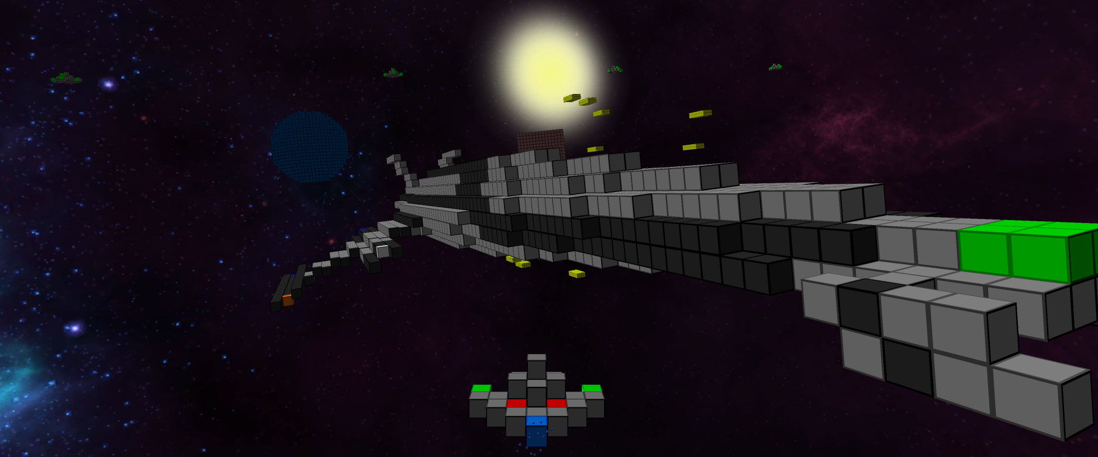
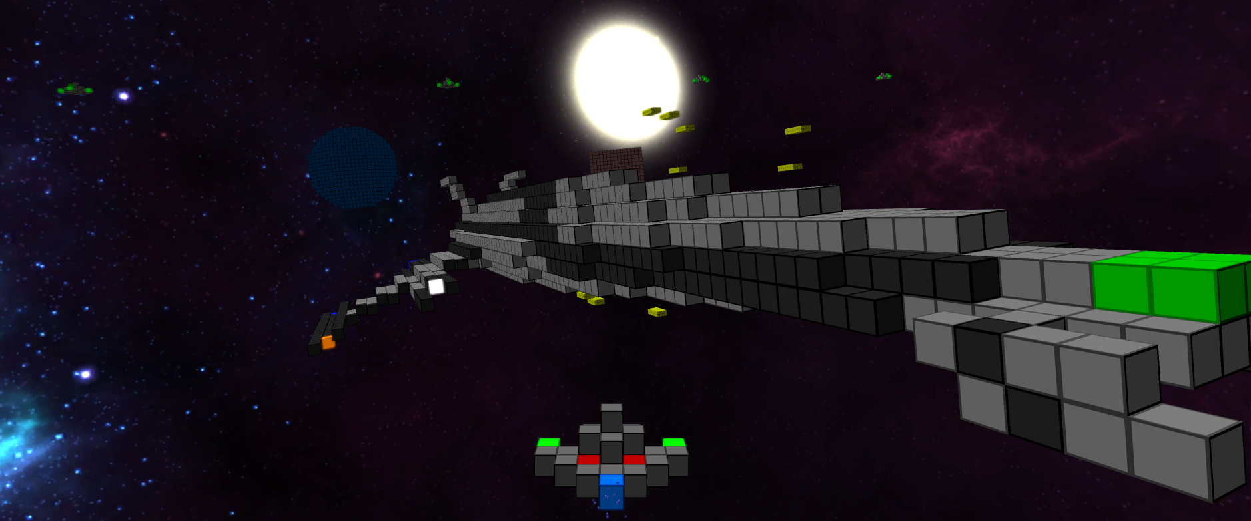
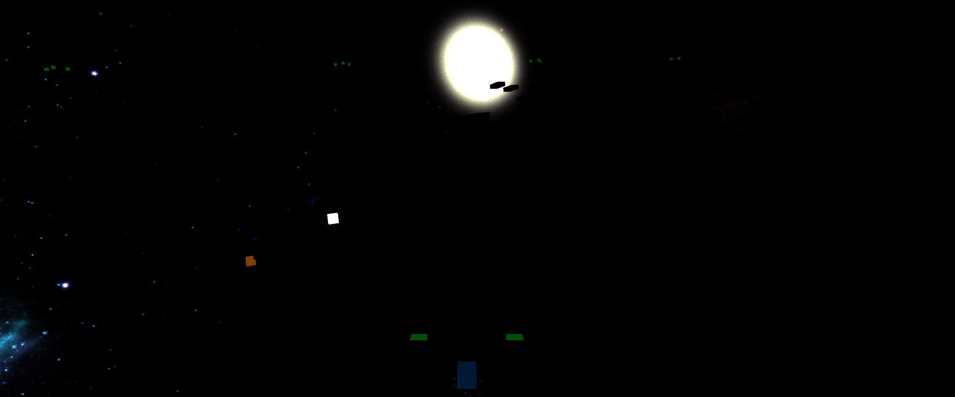

Postprocessing

Slide 31
RenderPipeline
auto pass = std::make_shared<PostProcessingPass>("blurv", m_quad);
pass->setInputMapping({ { "source", BufferNames::Emissisiveness } });
pass->setOutput({ BufferNames::BlurTmp });
pass->setFragmentShader("data/shader/postprocessing/blur.frag");
pass->setUniform("direction", glm::vec2(0, 1));
dd(pass)

Slide 32
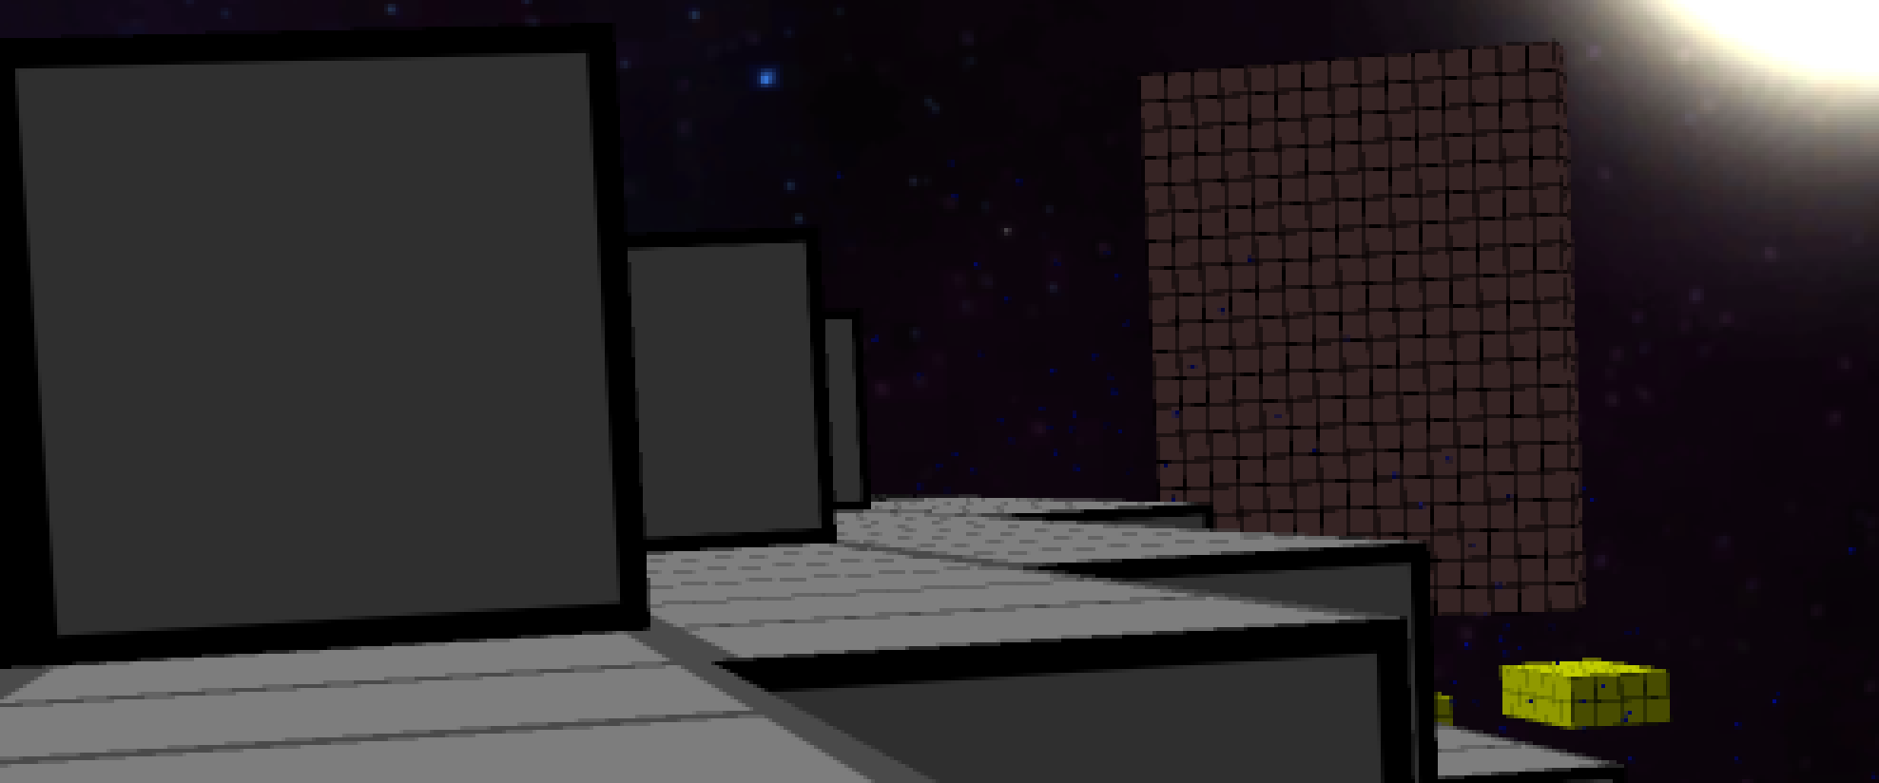
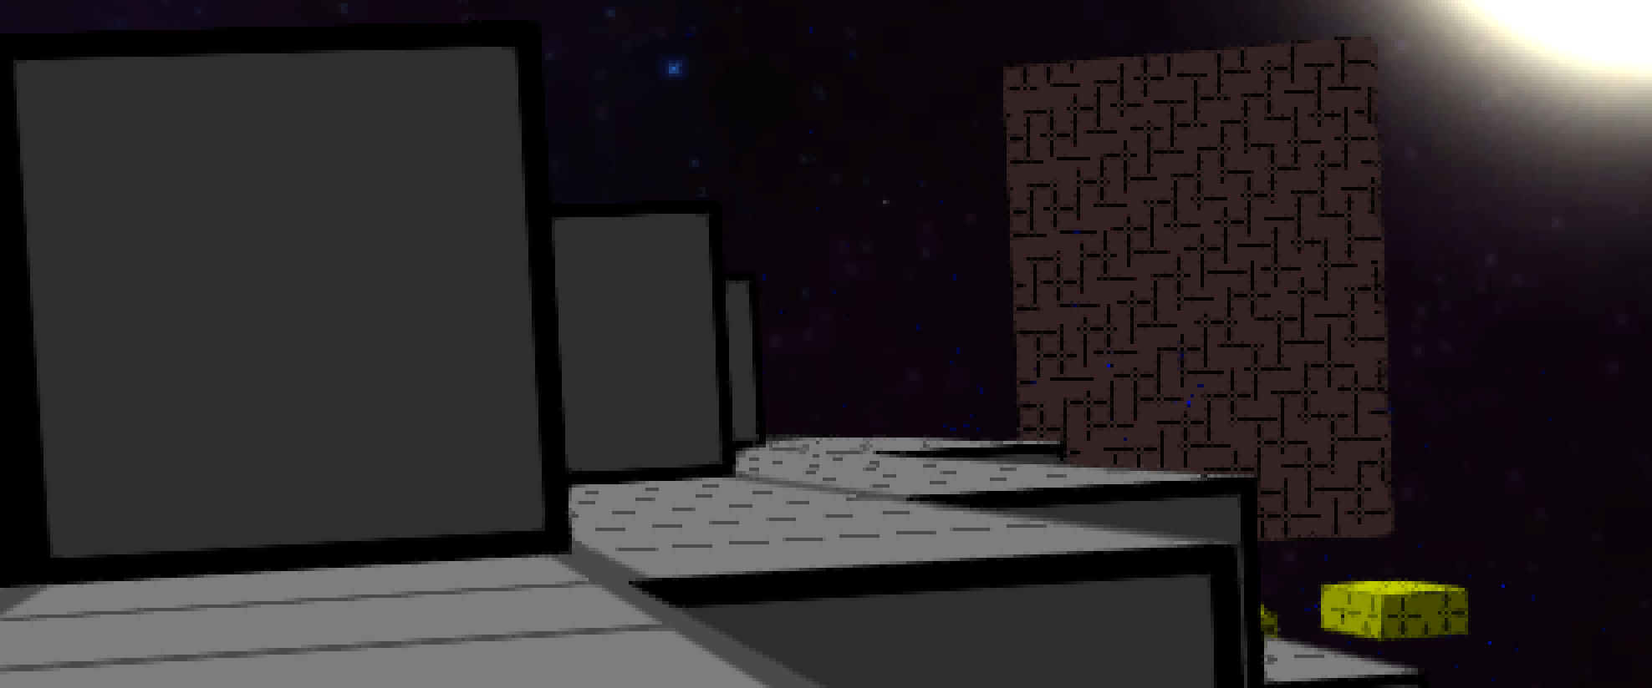

Antialiasing
fxaa
2x super sampling
without

Slide 33
Libraries & Tools
GLFW
GLOW
GLEW
GLM
FMOD -> SFML Audio
OculusSDK
LUA
Elemate Lua Bindings
Bandit
Git
github.com/voxelinc/voxellancer
Jenkins

Slide 34
Statistiken & Fakten

Slide 35

Milestones and Features
Done
different Ships
Various Controls (configurable)
Collision & Physics
Different Weapons & Engines
Battles with many Explosions
Visual Effects & Postprocessing
AI, Formations and Factions
Scripts, Missions
Oculus Rift
Not done (yet)
Menu
Item Drops
Open World
Mulitplayer
Milestone 17.12.2013
Rendering, collisions and movement of voxel-objects
Flying a ship that can destroy inanimate objects and simple AI-ships

Slide 36
